Slide 1


AGE 219: Data Structures
and Collections
Organizing Complex Agricultural Informatics
Dr. Kadeghe Fue, PhD, P.Eng (T)
AI & Robotics Specialist | Office: EPAL | SoET SUA

Slide 2
Recap: Lecture 5
We explored Functions: creating modular, reusable code machines (parameters, logic, and returns) to eliminate redundancy.

Slide 3


Beyond Simple Variables
Individual Data Points
The Need for Collections
So far, we have used single variables to store single values (e.g., temp = 25.5). This works for small scripts.
Data Structures allow us to group multiple items together into a single "Collection" under one variable name.
But how do we handle 1,000 sensor readings or a database of 50 tractors?
This is essential for Big Data analysis in precision agriculture.

Slide 4


Why Data Structures Matter?
Scaling Agricultural Systems
An autonomous tractor generates millions of data points per hour. Without efficient structures, processing this would crash the system.
Store sensor arrays.
Map GPS coordinates.
Manage fleet metadata.

Slide 5
1. Python Lists
Ordered, Mutable, and Versatile Collections.

Slide 6



Defining and Syntax
What is a List?
Syntax Example
An ordered collection of items wrapped in square brackets [ ]. Elements are separated by commas.
Lists are mutable (you can change them after creation).

Slide 7
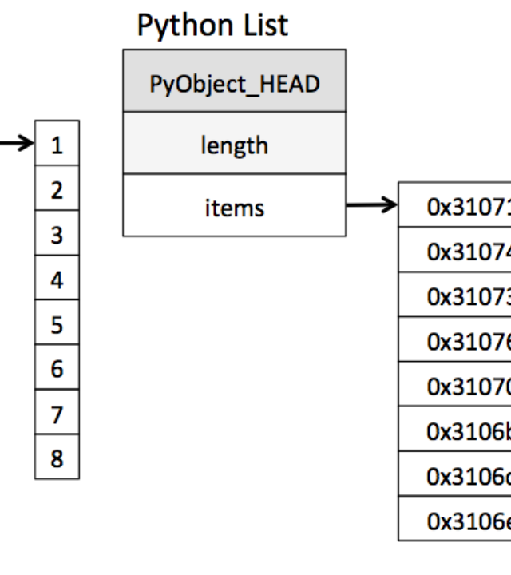
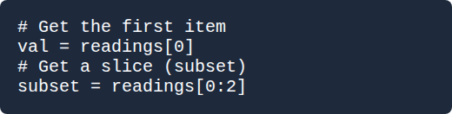
Indexing and Slicing
Accessing Elements
Python uses zero-based indexing. The first item is at position 0.

Slide 8






Common List Methods
.append()
.remove()
.sort()
Adds an item to the end of the list (e.g., a new log entry).
Deletes the first occurrence of a specific value.
Organizes numbers or strings in ascending/descending order.

Slide 9
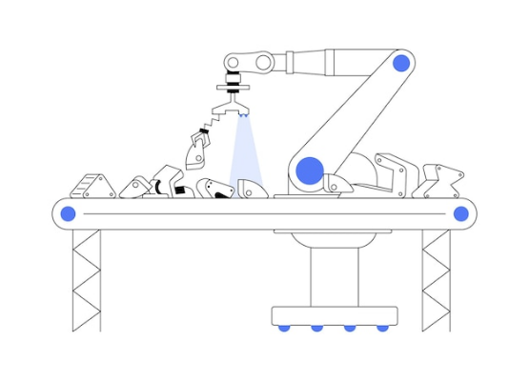

List Comprehensions
Engineered Efficiency
A shorthand way to create lists based on existing ones. Extremely powerful for unit conversions.

Slide 10
2. Tuples
Immutable, Fixed-Length Records.

Slide 11

Tuples vs. Lists
Fixed Integrity
Use Case: GPS
Tuples are defined using parentheses ( ). Unlike lists, they cannot be changed after creation (Immutable).
Safety: A tuple prevents code from accidentally changing coordinates.
Use them for data that must remain constant throughout a simulation.

Slide 12
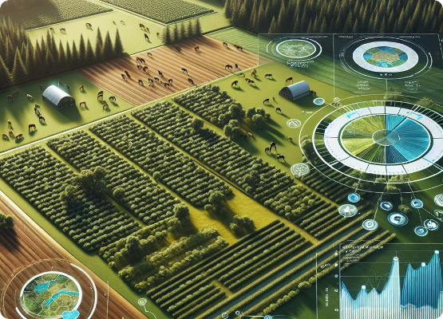
GPS Mapping Application
Mapping Farm Blocks
We often store a list of tuples to represent the boundary coordinates of a research plot.
Processing this "Route" allows for path-planning logic in autonomous robotics.

Slide 13
3. Dictionaries
Mapping Systems with Key-Value Pairs.

Slide 14
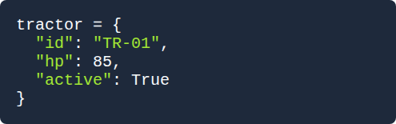
Key-Value Logic
The Digital Warehouse
Example Syntax
Dictionaries use curly braces { }. They store pairs of information: a unique Key and its Value.
Used to store complex metadata about farm equipment.

Slide 15

IoT Metadata Hub
Organizing Sensors
Dictionaries allow us to instantly look up a sensor reading using its ID, rather than searching through a long list.
Efficiency: Constant time lookup ($O(1)$) makes dictionaries extremely fast for search operations.

Slide 16






Dictionary Methods
.keys()
.values()
.items()
Retrieves only the identifiers (e.g., list of all tractor IDs).
Retrieves only the stored data (e.g., all current moisture levels).
Retrieves pairs, perfect for iterating over in loops.

Slide 17

4. Sets: Unique Items
Removing Duplicates
Sets are unordered collections with no duplicate elements. Wrapped in { }.
Perfect for identifying the unique types of crops currently stored in 100 different silos.

Slide 18
Data Structure Summary
Structure | Bracket | Ordered? | Mutable? | Best For
List | [ ] | Yes | Yes | Sequences & Sensor Logs
Tuple | ( ) | Yes | No | Constants & Coordinates
Dict | { } | No | Yes | Metadata & Fast Lookups
Set | { } | No | Yes | Unique Item Validation

Slide 19
Computational Efficiency
O(1)
Why Dicts Win
Searching for a value in a list of 1 million items takes 1 million checks ($O(n)$). In a dictionary, it takes only one check ($O(1)$) using a hash map.
Lookup Speed
As AI and Robotics engineers, choosing the right structure is the difference between a real-time system and a laggy one.

Slide 20
Best Practices
Consistency: Keep list elements of the same data type.
Meaningful Keys: Use descriptive strings as dictionary keys.
Nesting Safely: Avoid nesting deeper than 3 levels to maintain readability.
Memory Management: Use tuples for fixed data to save RAM overhead.

Slide 21
Activity: Farm Inventory
Design a list of dictionaries to represent a fleet of 3 drones, storing their ID, Battery %, and Status. Then write a loop to print only those with < 20% battery.

Slide 22

Questions?
Thank you for your attention.
Next Lecture: File Handling — Saving Agricultural Logs
School of Engineering and Technology (SoET) | SUA Morogoro

